Slide 1


Synthetic Sentries: Safeguarding AI with Next Generation Security Mechanisms
Imagine a world where AI systems are like superheroes, working hard to make our lives easier. But even superheroes need protection from Antagonists. “Synthetic Sentries: Safeguarding AI with Next Generation Security Mechanisms" is about creating special, high-tech protectors that keep our AI heroes safe from harm. These smart guardians make sure AI stays strong and always reliable.
by BARANI R

Slide 2

The Rise of AI and its Security Implications
1
Transformative Power
The rise of Artificial Intelligence (AI) has brought significant advancements to many fields, from healthcare, finance, transportation and entertainment.
2
Security Risks
However, these benefits come with serious security risks as well. AI systems can be targeted by hackers who might manipulate them to make wrong decisions, leading to harmful consequences.
3
Protecting AI
Protecting AI from these threats is crucial, as its misuse can have wide-reaching impacts on society. As AI continues to grow, ensuring its security will be essential to maintaining trust and safety in our increasingly digital world.

Slide 3
Potential Vulnerabilities and Security Risks of AI
Data Privacy Concerns
Unauthorized Access and Data Breaches
Bias and Discrimination
Protecting sensitive information from being exposed or misused.
Avoiding unfair treatment or decisions by AI based on biased data.
Preventing hackers from breaking into systems and stealing data.

Slide 4
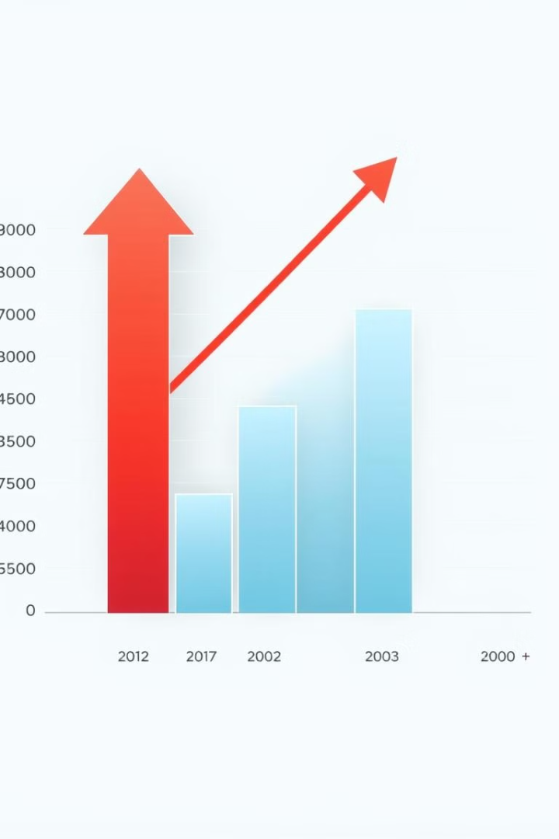
Statistics on AI-related Security Incidents and their Impacts
Category
Details
Frequency of AI Security Incidents
- 41% of organizations reported experiencing an AI-related security incident within the past year (Gartner, 2023). - 162% increase in AI security incidents from 2020 to 2023.
Types of AI Security Incidents
- Data poisoning attacks: 30% - Model inversion and extraction attempts: 25% - Adversarial attacks: 20% - Prompt injection attacks (GenAI): 15% - Other attacks (model theft, API abuse): 10%
Impact on Different Sectors
- Financial Services: 38% of firms reported financial losses due to AI security breaches. - Healthcare: 28% experienced data privacy violations related to AI. - Manufacturing: 33% faced disruptions in AI-driven processes. - Retail: 35% reported reputational damage.

Slide 5

Limitations in Current Security Mechanisms to Safeguard AI
Limited Visibility
Traditional security mechanisms operate at the network or system level. Lack of insight into AI model internals and data processing.
Inadequate Handling
Struggles to analyse complex AI inputs like images or natural language. Unable to evaluate the safety of AI-generated content.
Lack of Adaptive Learning
Most security tools don't use AI to improve their own performance. Unable to anticipate new threats based on observed patterns.
Insufficient Protection
Traditional security focuses on data integrity, not subtle manipulations. It Struggles to detect malicious data that influences AI learning.

Slide 6
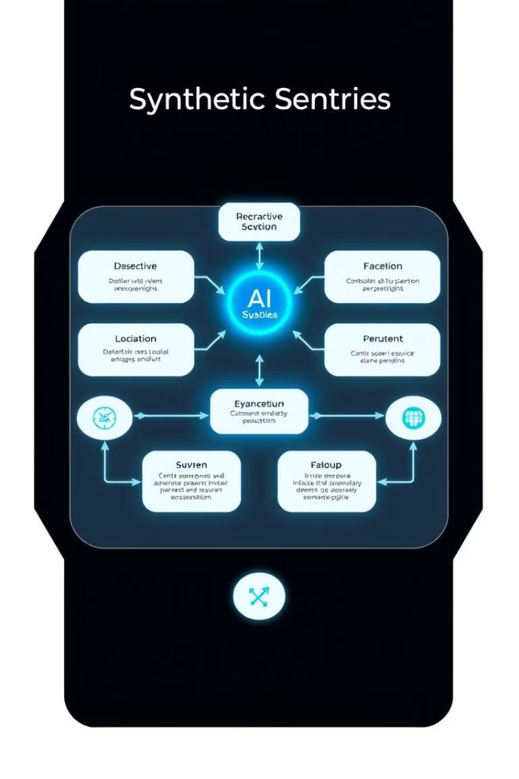




Overview of Synthetic Sentries Architecture
Input Layer
This is where the system receives data from external sources.
Synthetic Sentries Layer
This central layer includes several specialized modules that work together to protect the AI system.
AI System Core
This is the heart of the system where the AI processes the input data and makes decisions.
Output Layer
The processed information or decisions made by the AI are delivered through this layer.

Slide 7




Components of Synthetic Sentries
Anomaly Detection Module
Access Control Module
Threat Intelligence Module
Intrusion Prevention Module
This acts as the first line of defence by continuously monitoring the AI's behaviour. It learns what is considered normal for the AI and quickly identifies any deviations, such as unusual outputs or behaviors, triggering alerts to other modules.
This works closely with the Anomaly Detection Module by adapting access rules based on real-time user behavior and system conditions. It verifies user identities and restricts or modifies access if any suspicious activity is detected, effectively controlling who can interact with the AI and how.
It continuously gathers and analyse information on emerging threats from various sources. It shares this intelligence with the other components, particularly with the Intrusion Prevention Module, to update defense strategies and anticipate new types of attacks.
it takes a proactive role by using insights from the Threat Intelligence Module to block and prevent potential attacks. It acts immediately to stop suspicious activities and works in real-time to protect the AI system's core functions, ensuring that threats are neutralized before causing harm.

Slide 8
How Synthetic Sentries Differ from Traditional Security Measures
1
AI-Specific vs. General Cybersecurity
Designed specifically for AI system vulnerabilities. Understands the unique ways AI can be attacked or misused.
2
Adaptive Learning
Continuously learns and adapts to new AI behaviours and threats. Uses AI to improve its own security measures.
3
Integration with AI Systems
Deeply integrated into the AI system it protects. Can monitor internal AI processes and data flows.
4
Handling of AI Inputs and Outputs
Can understand and analyse complex AI inputs (e.g., prompts, images). Monitors AI outputs for unexpected or harmful content.
5
Privacy Preservation
Includes specialized techniques for AI data privacy (e.g., federated learning). Can protect data while still allowing AI to learn from it.
6
Proactive Threat Detection
Uses predictive models to anticipate potential AI attacks. Can simulate attacks to test AI system resilience.
7
Handling of Model Dynamics
Adapts to changes in AI model behaviour over time. Can secure AI systems that learn and evolve.
8
Ethical AI Considerations
Can monitor for biased or unfair AI outputs. Helps ensure responsible AI use.

